Slide 1




Patient-centred development and validation of the Patient-Reported Impact of Dermatological Diseases (PRIDD) measure
Dr Rachael Pattinson
Post-doc researcher, Cardiff University
On behalf of the GRIDD team

Slide 2



(GlobalSkin)

Slide 3
PROMs: Underused and underappreciated?
PROMs
Research
Clinical practice
Intervention evaluation
Patient-centred
Self-management
Shared decision-making
Measurement instrument
Evidence of burden
“A measurement based on a report that comes directly from the patient (i.e. study subject) about the status of a patient’s health condition without amendment or interpretation of the patient’s response by a clinician or anyone else.”
— FDA (2009)

Slide 4
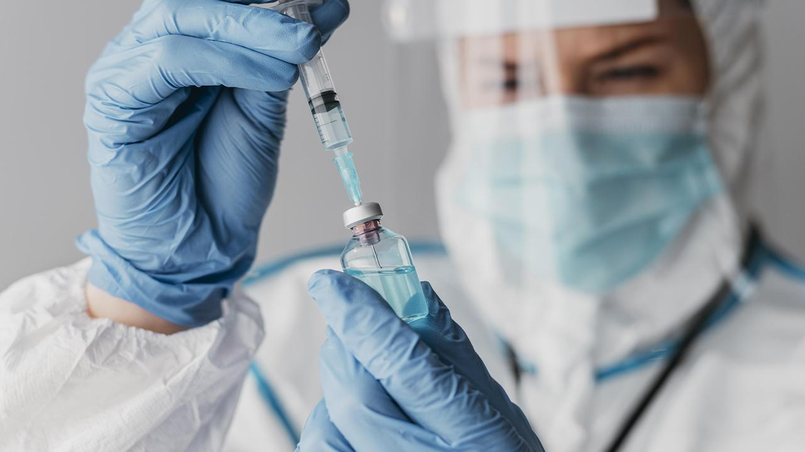
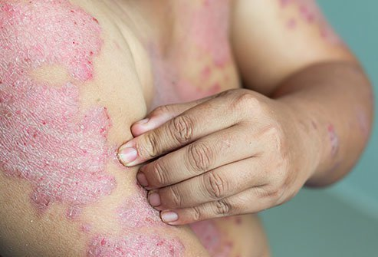

The Global Research on the Impact of Dermatological Diseases (GRIDD) project
Aim: To collect global data on the impact of dermatological conditions on patients’ lives.

Slide 5

The Patient-Reported Impact of Dermatological Diseases (PRIDD) measure
Target population
Adults (≥ 18 years) worldwide living with a dermatological condition
Target construct
Impact of dermatological conditions on the patient’s life
Application
Research and clinical practice

Slide 6
Measure development and validation methodology
Literature review
Expert opinion
Patient perspective
2018 - 2023
Develop conceptual model to identify relevant domains and issues
Item generation based on conceptual framework
Content validity phase
Cognitive interviewing
Refine measure based on cognitive interviewing and format validation ready version
Conduct validation study and refine measure based on findings
We are here
Psychometric phase
Final measure

Slide 7
Conceptual framework of the impact of dermatological conditions
Impact
Physical impacts
Symptoms, Secondary impacts (e.g. scarring), General health impacts, Sleep disturbance
Psychological impacts
Cognitions, Emotions, Coping behaviors
Impact domains
Example impacts
Social impacts
Financial impacts
Construct of impact
Social isolation, Romantic relationships, Other people’s reactions
Daily responsibilities
Out-of-pocket expenses, Loss of earnings
Work, Study, Daily routine and tasks (e.g. caring)
263 shared impacts
n = 65, diseases = 29, countries = 29

Slide 8
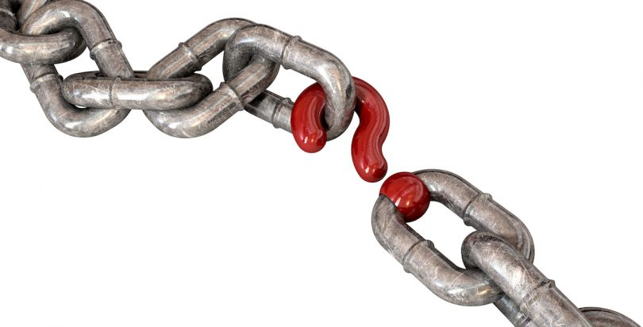

Slide 9
Delphi study
Rank | Item | Impact group
1 | My skin is sensitive | Physical
2 | The quality, look and feel of my nails, skin, hair bothers me | Physical
3 | I experience physical discomfort, soreness or irritation | Physical
4 | I feel dismissed or abandoned by the healthcare system | Psychological
5 | I cope by living a healthy lifestyle | Psychological
6 | My leisure time/activities are affected | Daily life and responsibilities
7 | I have been affected financially | Financial
8 | My life choices are affected (e.g. choice to have children) | Psychological
9 | I rely on others to help me cope | Psychological
10 | My daily routine has had to accommodate my condition | Daily life and responsibilities
11 | My education has been affected | Daily life and responsibilities
12 | I worry about other health consequences | Psychological
13 | I worry about social situations | Psychological
14 | I am tired, fatigued or lack energy | Physical
15 | My everyday choices are affected (e.g. clothes, food, drink, products) | Psychological
16 | I cope by avoiding challenges | Psychological
17 | I often feel unsure or uncertain | Psychological
18 | My general health has been affected | Physical
19 | I am stressed | Psychological
20 | My sleep is disturbed | Physical
Top 20 most important impacts of dermatological conditions
n = 1154, diseases = 90, countries = 61

Slide 10
Pilot testing PRIDD: cognitive interviews
Phase 4
"I’ve completed a lot of dermatological questionnaires, but I don’t think I’ve ever seen them all integrated like this in such a questionnaire … I’m very, very happy with this. It has stirred my heart … There are things here that I wanted to discuss with my dermatologist … I’m really, really impressed with this. It’s very good, it’s excellent." (Participant 5)
n = 12, diseases = 6, countries = 4

Slide 11
PRIDD domains and items
Impact
Physical Impact
Physical discomfort, sleep disturbance, fatigue, general health
Life Responsibilities
Treatment problems, leisure, everyday choices, extra expenses, independence
Impact domains
Psychological Impact
Social Impact
Construct of impact
Anxiety, depression, hypervigilance
Relationships with close ones, social life and interactions, sexual intimacy, ability to perform social roles
Item concepts
16 items,
4 domains
n = 483, diseases = 50, countries = 42

Slide 12
Psychometric testing
Survey 1
504 participants; 35 conditions; 38 countries
Structural validity, internal consistency; construct validity
Survey 2
272 participants; 27 conditions; 26 countries
Test-retest validity; measurement error; responsiveness
Does PRIDD work at a point in time?
Does PRIDD work across time?

Slide 13


Measurement property |  | Requirement | Rating | Results
Structural validity | Unidimensionality | - No violation of unidimensionality - No violation of local independence - Adequate model fit: 2 >0.01 | + | PRIDD and all subscales unidimensional with no local dependency. χ2 = 0.11
 | Structural validity | CFI or TLI or comparable measure >0.95 OR RMSEA <0.06 OR SRMR <0.08 | + | CFI = 0.96; TLF = 0.97; RMSEA = 0.09; SRMR = 0.03
Internal consistency |  | Person Separation Index ≥ 0.7 | + | Person Separation Index = 0.89
Hypothesis testing for construct validity |  | 75% of hypotheses met | + | 76% of hypotheses met
Test-retest reliability |  | ICC or weighted Kappa ≥ 0.70 | + | ICC = 0.93
Measurement error |  | SDC or LoA < MIC | ? | Unable to determine anchor-based MIC
Responsiveness |  | The result is in accordance with the hypothesis OR AUC ≥ 0.70 | - | 0 hypotheses met
“+” = sufficient
” –“ = insufficient
“?” = indeterminate

Slide 14
PROMs play a key role in research and clinical practice
PROMs need to be high-quality and developed alongside patients
GRIDD is template for patient involvement in PROM development and validation

Slide 15
THANKS!
Do you have any questions?
pattinsonr@cardiff.ac.uk
Notes:
Thank you for listening to this presentation.
You can find out more about the GRIDD project by scanning the QR on the screen.

